Slide 1
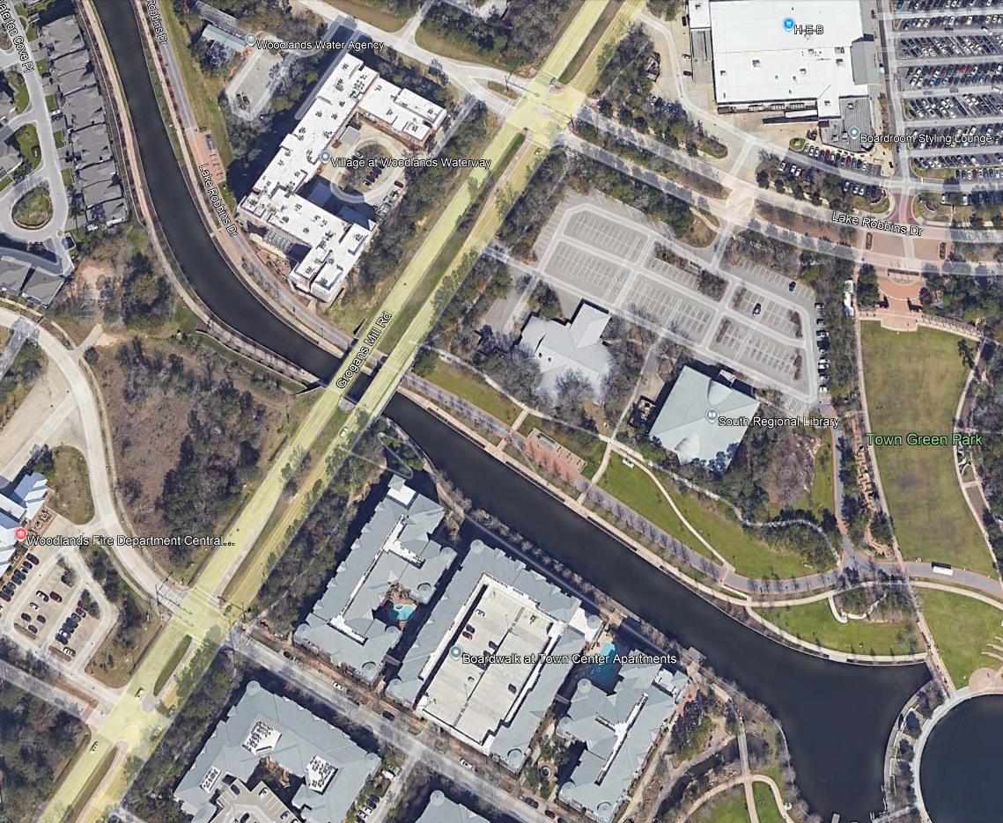
LOWER WATERWAY – PHASE 1
52 pole lights
8 Trolley lights
2 Trolley Stops
4 Bollards
4 Benches
2 Trashcans

